Slide 1
PAX TEC Progress
Report # 2
Dr. Craig Christensen
April 25, 2003

Slide 2
Summary of Principal Phases
FEATURES RESULTS
PHASE I PAX Emulator Built Heat Sink Ineffective
(from Polyurethane Foam Insulation Foam Melting
Progress 2 x 28 W TE Coolers
Report Small Heatsinks (HS1)
#1) Large Fans
Test in Temperature Chamber
PHASE II Large Heat Sinks (HS2) Small Fan Air Flow is Ineffective
Polyisocyanurate Foam Insulation Need more powerful fans
15 CFM Fans used (small) No. and capacity of TECs still TBD
2x28 or 2x39 W TE Coolers
PHASE III Guided Large Fans into 2 Vent Holes 2 TE Coolers Inadequate
Variety of TE Coolers tried Best Fan Orientation was Determined
PHASE IV 4 TE Coolers used – Placement of TE Coolers
HS2 and HS1 in Collinear Placement Determined Inefficient
PHASE V 4 TE Coolers placed side-by-side Thermal Objective
& moved to Thermal Center of Gravity Achieved
Guided Fan Structure – Wedge Shape

Slide 3
Objective and Design Constraints
Objective
  Maintain the PAX at 20 ± 3 deg C under all operation conditions
Design constraints
  Internal (active) power generated can be up to 10 W
  Passive power through the insulation can be up to 5 W
  Ambient temperature can range from – 29 to + 43.4 deg C
  Air provided by cryo-coolers is 15 CFM at no hotter than 35 deg C (this information was obtained after completion of Phase I)
  Headroom for the TE cooling system and fins = 1.8 inches
  Ducting (as originally suggested to PSI): two 2” × 1.8” cross-sectional passages along the 10.75” length of the PAX bottom plate

Slide 4
Evolution of the First Working Solution
This work was performed in five phases:
Phase I: Initial PAX Emulator Test
Phase II: Hardware Upgrades
Phase III: Experimentation with Fan Configuration
Phase IV: Further TE Cooler Upgrade
Phase V: Rearrangement of TE Coolers, Ducting, and
Heat Fins

Slide 5
Phase I: Initial PAX Emulator Test
PAX emulator box was built
  10.5” × 12.5” × 2” box made of ¼” aluminum plate
  Resistive loads judiciously placed to emulate the internal heat load
  9 temperature sensors placed to monitor the thermal distribution
  Polyurethane foam insulation encapsulated the box
  Two 28-W TE coolers were mounted on ½”-thick aluminum blocks placed at halfway point along the cooling duct path
    Assumptions: COP = 30%
    Each 28-W TE cooler could remove 7.5 W
  Two 5” × 5” fans were used to cool the heat fins
Initial test was performed under simulated PAX operating conditions, except for the air flow

Slide 6
Phase I Test Results Summary
Active
Load
T_{ambient}
(deg C)
Observation
10 W
20
Cooling system maintained PAX temperature at 20 deg C
34 – 36
Cooling system was unable to maintain PAX temperature below 30 deg C
Some of the insulation melted
Conclusions from Phase I test:
  Better heat sink needed to reduce thermal resistance of heat fins (presently at ~ 1.3 rather than anticipated 0.55 deg C/W)
  Insulation with higher melting temperature needed

Slide 7
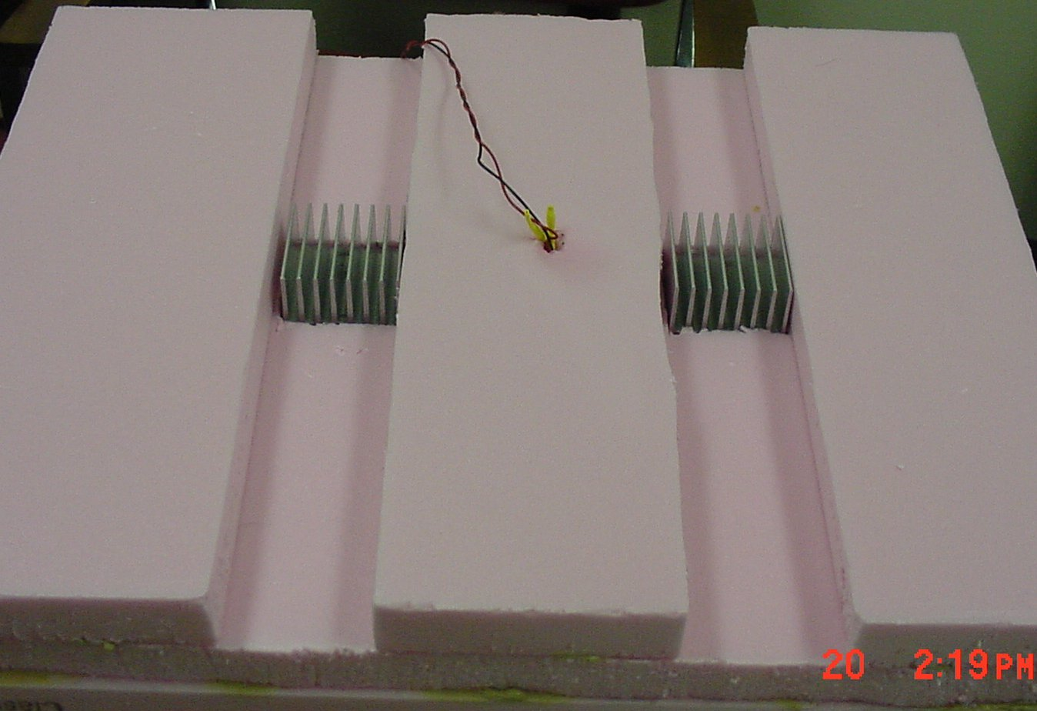
Phase I Cooling Duct

Slide 8
Phase II: Hardware Upgrades
Heat sink upgrade: 2 Therma-Shield heat sinks
  New Assumption:
  Temperature of air provided to heat sinks ≤ 35 deg C (from cryo-cooler output) rather than worst-case ambient air of 43.4 deg C
  Calculation:
  Air flow of 15 CFM split into two paths through 2” × 1.8” vent system = 300 LFM past heat sinks
  = thermal resistance of 0.55 deg C/W
Insulation upgrade: polyisocyanurate in ‘ring’ sections
  Material can sustain temperatures up to 122 deg C
  Stacked Rings more closely approximates final insulation structure
  Thermal coefficient (0.020 W/M deg K) slightly better than that of polyurethane (0.026 W/M deg K)
Fan upgrade: two more fans
  Air flow was emulated using two 7.2-CFM fans to push air into ducting, and two more to draw it out at exhaust (in lieu of any info on available static pressure performance)
  Coolers were moved closer to input fans
  (at distance of 1/3 the cooling duct length)

Slide 9
Phase II Test
Step 1
  Run TE coolers at full voltage (15 V) in ambient of 22 – 24 deg C.
  Monitor capacity of the cooling system to reduce PAX temperature over 30 minutes or more
Step 2
  Increase ambient to 43 – 44 deg C
  Monitor PAX temperature every 5 minutes
  Terminate test after PAX temperature reaches 26 deg C
    This termination condition was adopted under the assumption that the PAX would operate at 23 ± 3 deg C. This turned out to be incorrect.

Slide 10
Phase II Test Results
Step
Active
Load
T_{ambient}
(deg C)
Observation
1
Off
23.8
PAX cooled from 20.23 to 13.01 deg C in 30 minutes
1
10 W
23.8
PAX cooled from 17.98 to 15.01 deg C in 30 minutes
2
10 W
40.0
PAX cooled from 26.74 to only 25.59 deg C before rising again

Slide 11
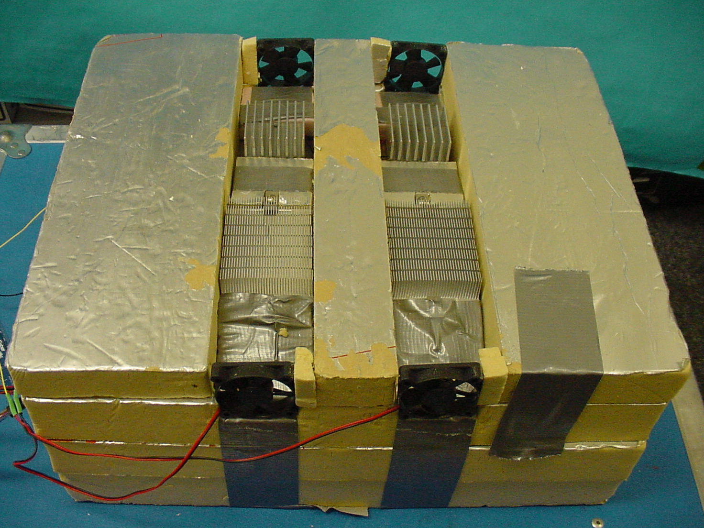
Phases II - IV Represented
out
in
Fans for Phase II only

Slide 12
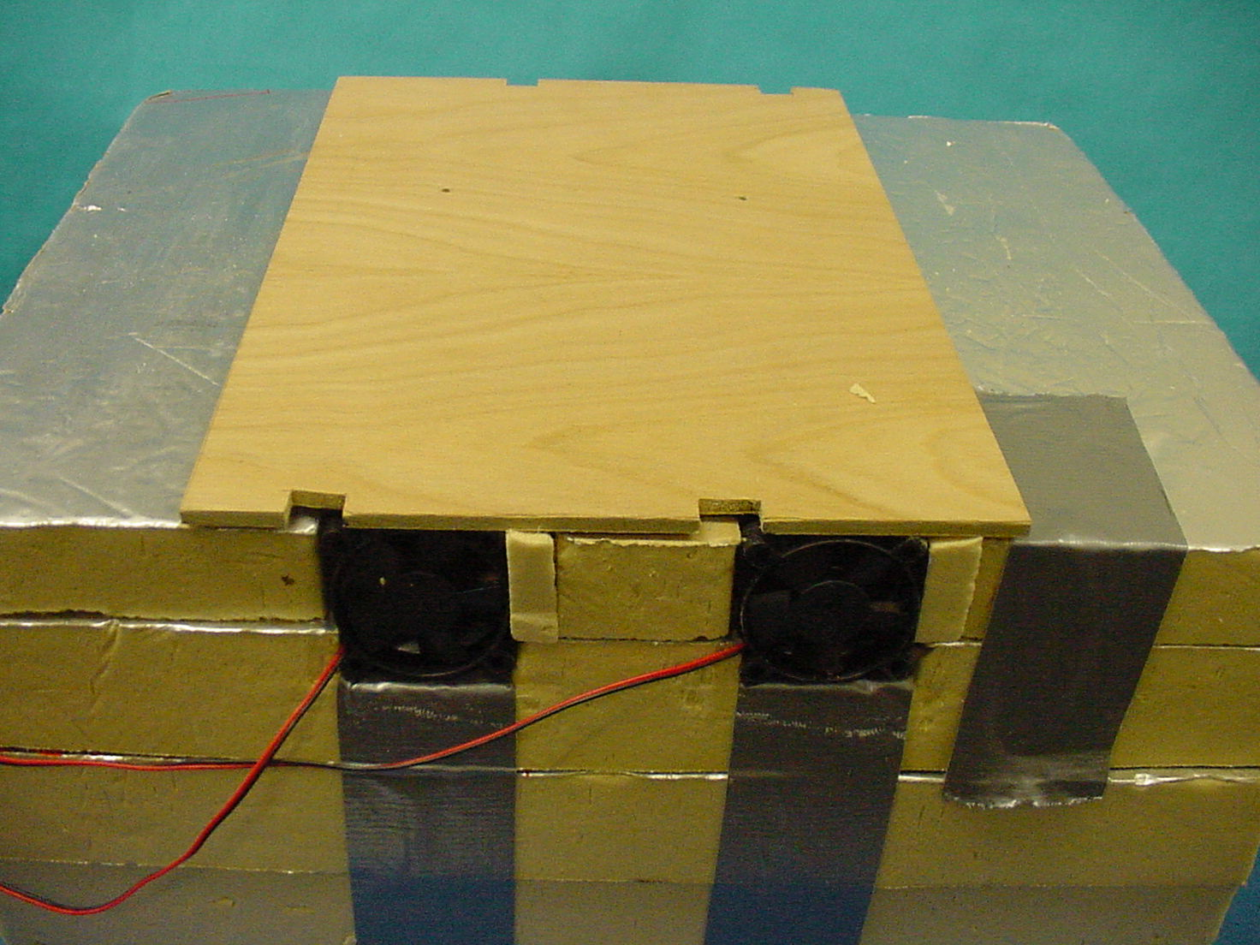
Phase II – Lid Covering Duct

Slide 13
Phase II Test Results
After Additional Upgrade to Coolers and Fans
Pair of 28-W coolers was replaced with 38-W pair
Small foursome of 7.2-CFM fans were replaced by two larger fans (5” × 5”, each 70 – 100-CFM, initially placed flush against outside of vent access holes)
Conclusion (before bothering with Step 2): 15 CFM air flow is insufficient to remove the heat generated by the TE coolers
Step
Active
Load
T_{ambient}
(deg C)
Observation
1
10 W
23.0
PAX cooled from 18.32 to 15.49 deg C in 30 min., to 14.53 deg C in 60 min.

Slide 14
Phase III: Experimentation with Fan Configuration
Three placements of the fans were considered:
  Guided-air:
  A cardboard frame was built to guide air from fans into each of the two 2” × 2” vent openings
  Underneath:
  Fans could be placed immediately below the TE coolers and heat fins (at bottom of PAX, directed downwards)
  Combination:
  One set of fans underneath the TE and fins, blowing upwards; one set placed to drive the air laterally
Guided-air placement was determined to most efficiently remove heat from the cooling fin vicinity
Some experimentation was also done to get a better read on temperatures at different positions within the temperature-controlled chamber

Slide 15
Phase III Test Results
TE
Coolers
Active
Load
T_{ambient}
(deg C)
Observation
2 × 28 W
10 W
~ 30
PAX cooled from 21.43 to 21.26 deg C in 8 minutes before rising again
2 × 56 W
10 W
~ 30
PAX cooled from 21.70 to 15.78 deg C in 30 minutes
2 × 56 W
10 W
Rising
to ~ 43
PAX temperature rose from 21.16 to 23.39 deg C in 20 minutes
2 × 78 W
10 W
26.8
PAX cooled from 24.78 to 22.00 deg C in 15 minutes before rising again
Conclusions:
78-W TE cooler pair experience thermal ‘bottleneck’: more power is
flowing into them than they can extract
Two TE coolers may be inadequate to maintain the
PAX at ≤ 23 deg C in ambient of 43.4 deg C

Slide 16
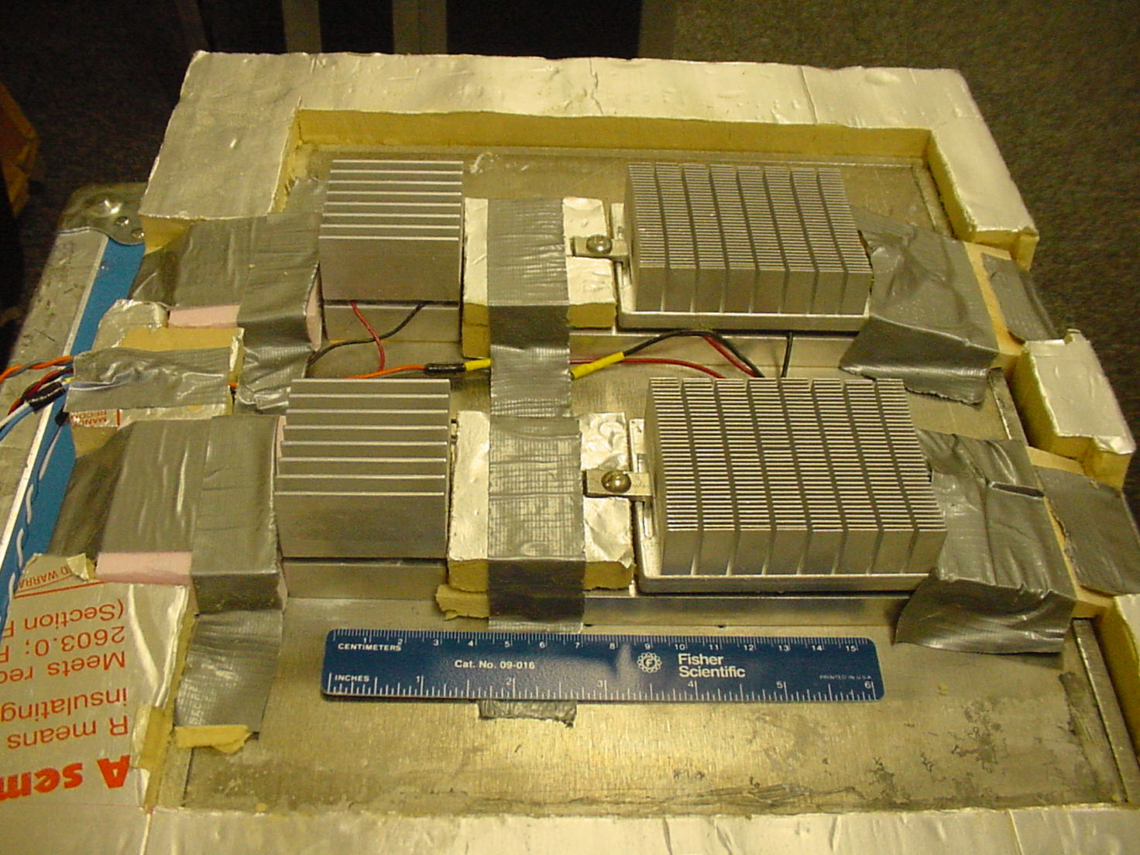
Phases III and IV Represented
Small Heat Sink Therma-Shield Heat Sink

Slide 17
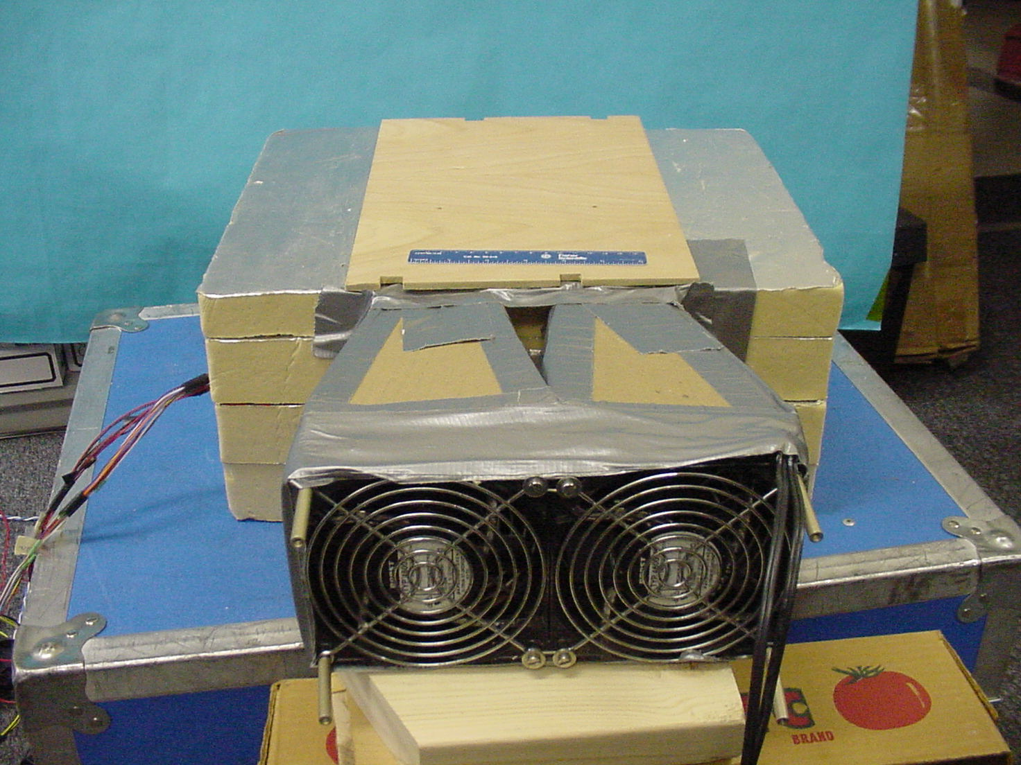
Phase III and IV Guided Fans

Slide 18
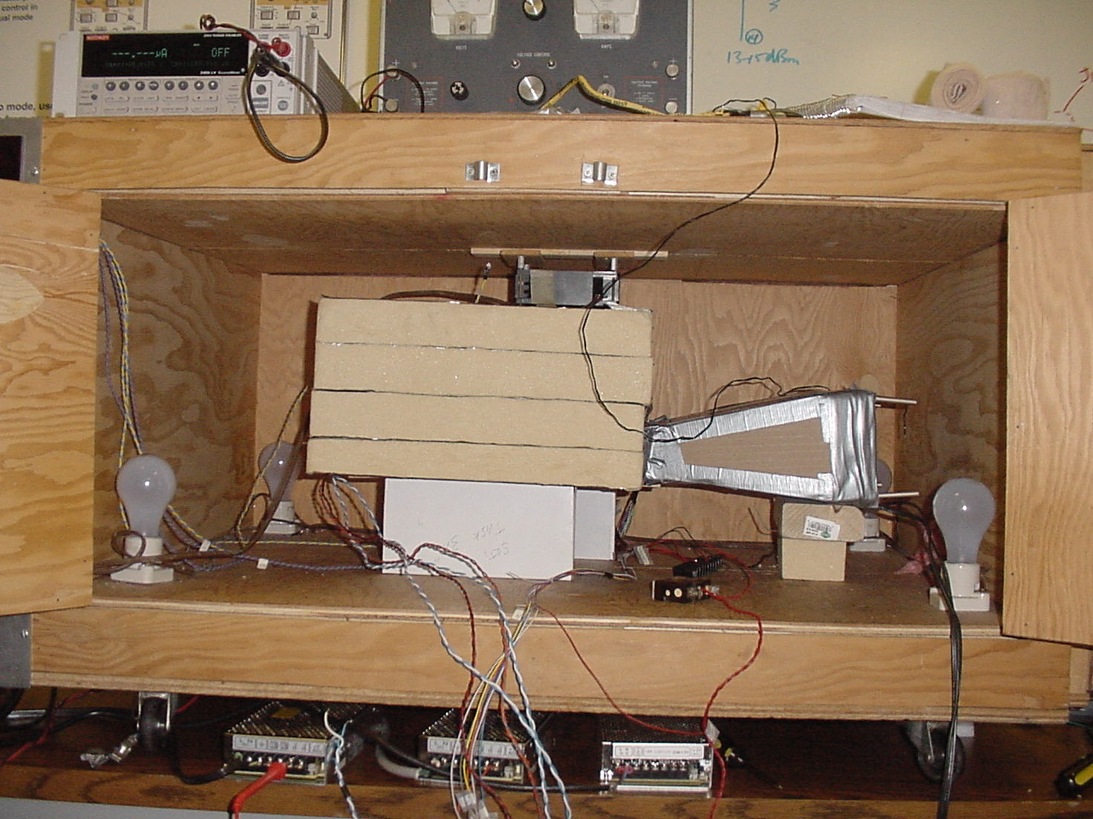
Phase III & IV Test Setup in Temp Chamber

Slide 19
Phase IV: Further TE Cooler Upgrade
Number of TE coolers was increased from 2 to 4
Two initial mounting blocks and heat fins were placed behind the Therma-Shield cooling fin system
  This was expedient, requiring just new mounting holes

Slide 20
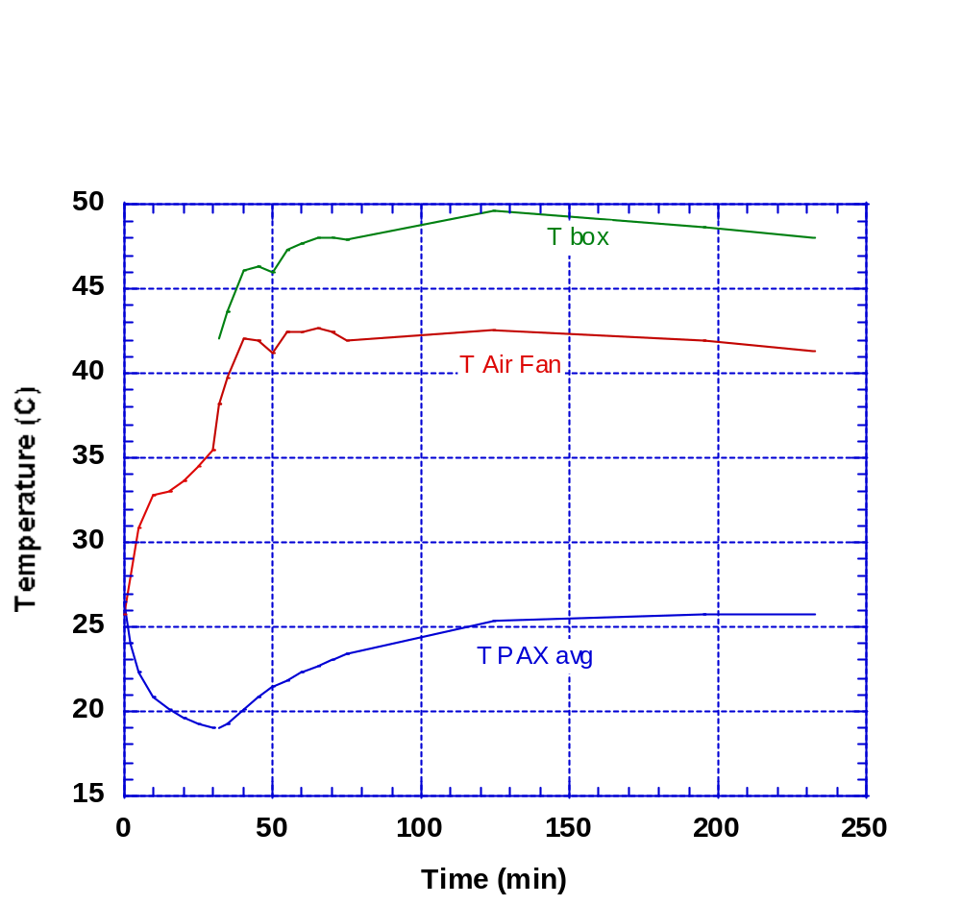
Phase IV Test Result for 2x56 & 2x39 W TECs
Low Ambient
Temperature
(step 2)
Elevated Ambient
Temperature (step 2)

Slide 21
Phase IV Test Results
TE Coolers: 4 × 39 W
Active
Load
Fans
T_{ambient}
(deg C)
Observation
10 W
2 × 70 –
100 CFM
23.6
PAX cooled from 20.79 to 15.49 deg C in 30 minutes
10 W
4 × 7.2
CFM
23.6, rising
to 27.4
PAX cooled from 25.01 to 22.76 deg C in 5 minutes, then heated to > 23.18 deg C by 10-minute mark *
10 W
2 × 70 –
100 CFM
27.4
PAX cooled from 25.34 to 18.49 deg C in 30 minutes; meanwhile, input air to fans rose from 23.7 to 32.2 deg C
10 W
2 × 70 –
100 CFM
Increasing
from 27.4
PAX heated from 18.60 to 23.00 deg C in 30 minutes; (PAX top: rose from 41.0 to 46.4 deg C; Air in fans: rose from 36.9 to 41.1 deg C)
This test reconfirmed inadequacy of small fans,
even with increased number of TECs

Slide 22
Phase IV Test Results, continued
TE Coolers: 2 × 39 W and 2 × 56 W; Fans: 2 × 70 – 100 CFM
Active
Load
T_{ambient}
(deg C)
Observation
10 W
Doors of chamber
open
PAX cooled from 26.51 to 19.09 deg C in 30 minutes; Air in fans: rose from 25.7 to 33.7 deg C
10 W
Allowed to heat up
PAX heated from 18.99 to 23.09 deg C in 40 minutes; Air in fans: rose from 38.2 to 42.7 deg C; PAX top: rose from 42.1 to 48.0 deg C
Conclusions:
Extra TE coolers are helping, but location in collinear air stream is
non-optimal
Since most of the heat is produced near rear of PAX, it would be
beneficial to place TE coolers towards that direction

Slide 23
Phase V:
Rearrangement of TE Coolers, Ducting, and Heat Fins
Four TE coolers were placed side-by-side at thermal center of gravity
  Thermal center of gravity: ~ 7” from front
  Previous location: ~ 3” from front (end closest to fans)
The guiding structure of the fans was reshaped as wedge without a partition for two access vents
Spacing above the heat fins was minimized to force the air to flow optimally through—rather than above—the fins

Slide 24
Phase V Test Results
TE Coolers: 2 × 39 W and 2 × 56 W
Time
T_{ambient}
(deg C)
T_{PAX}
(deg C)
T_{PAX top}
(deg C)
T_{air in fans}
(deg C)
T_{output air}
(deg C)
10 min
43.4
20.14 ⇒ 15.72
6 hours
43.4
15.72 ⇒ ~ 22.4
Stable at 43.8 after 1st 20 min
Stable at 51.9 after 1st 20 min
Stable at 60.8 after 1st 20 min
Conclusion:
Using 4 TE coolers in proper placement, with sufficient air flow, it is possible to stabilize the PAX temperature at under 22.5 deg C beyond the worst-case conditions.

Slide 25
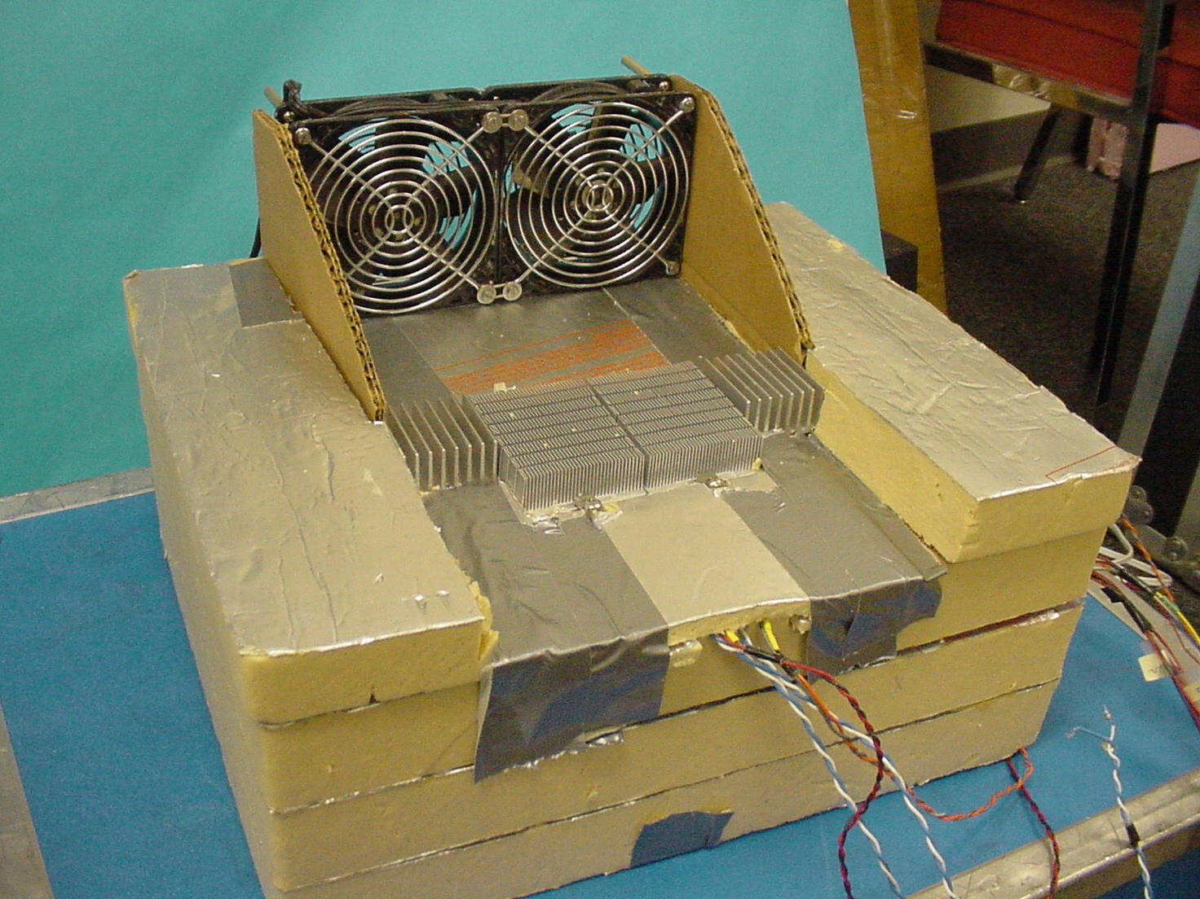
Phase V Structure

Slide 26
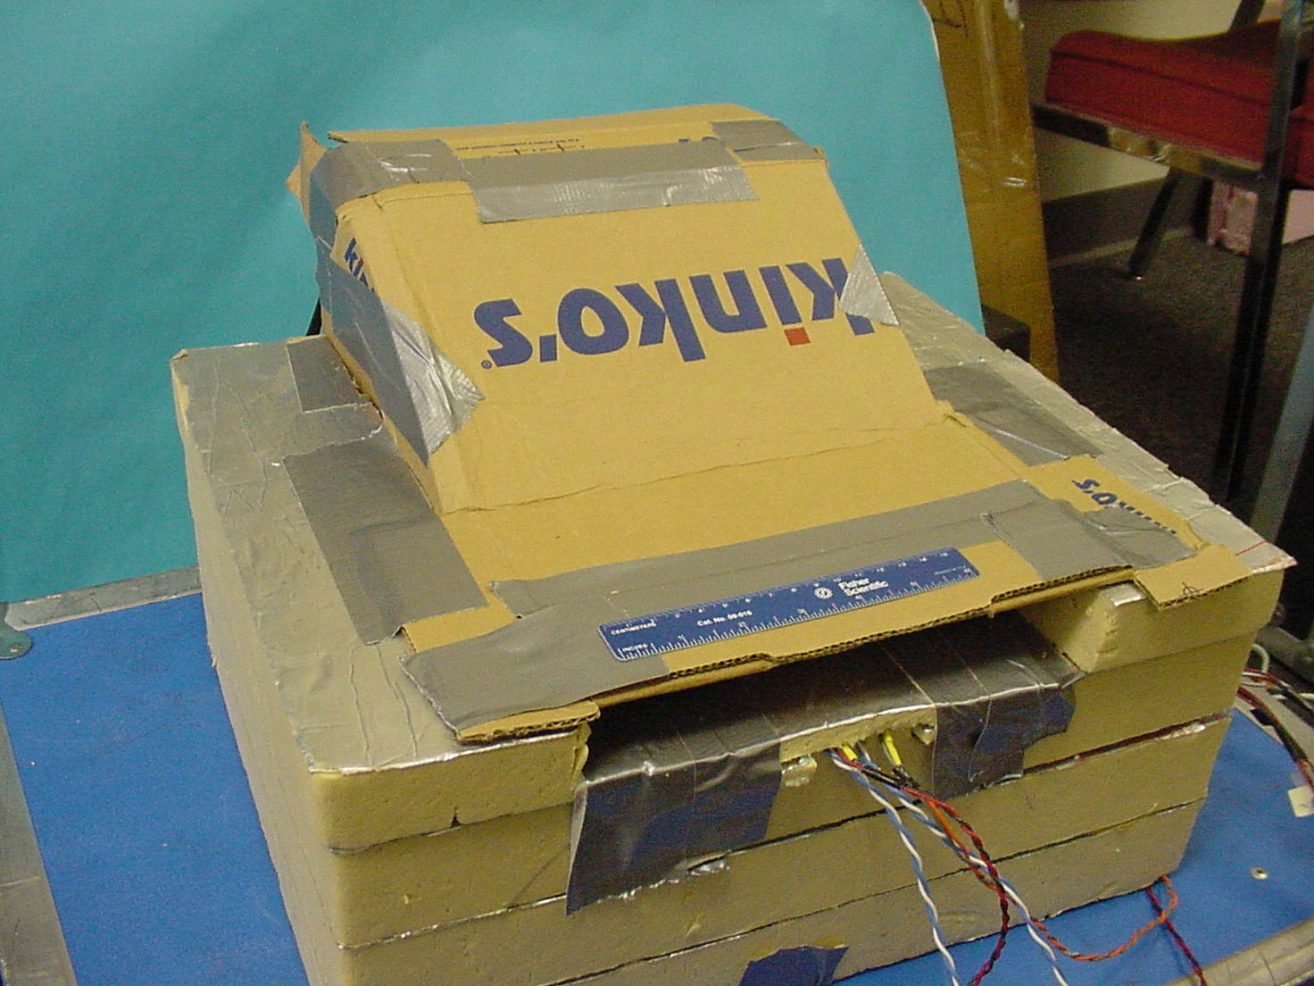
Phase V Closed ‘Wedge’ Fan Structure

Slide 27
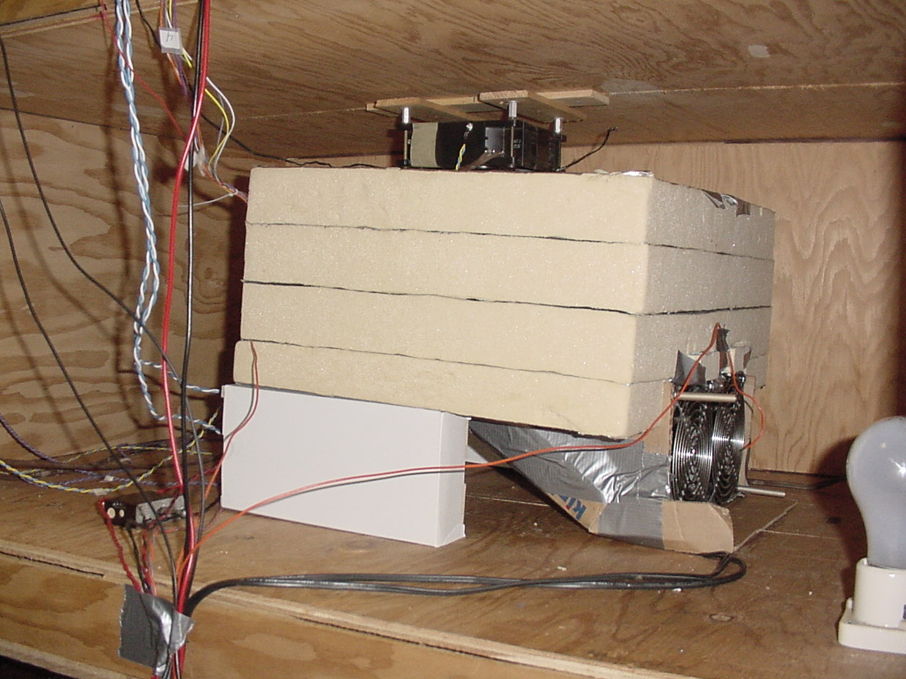
Phase V in Test Chamber
PAX top
Air out
Air in
Temp Sensors Indicated

Slide 28
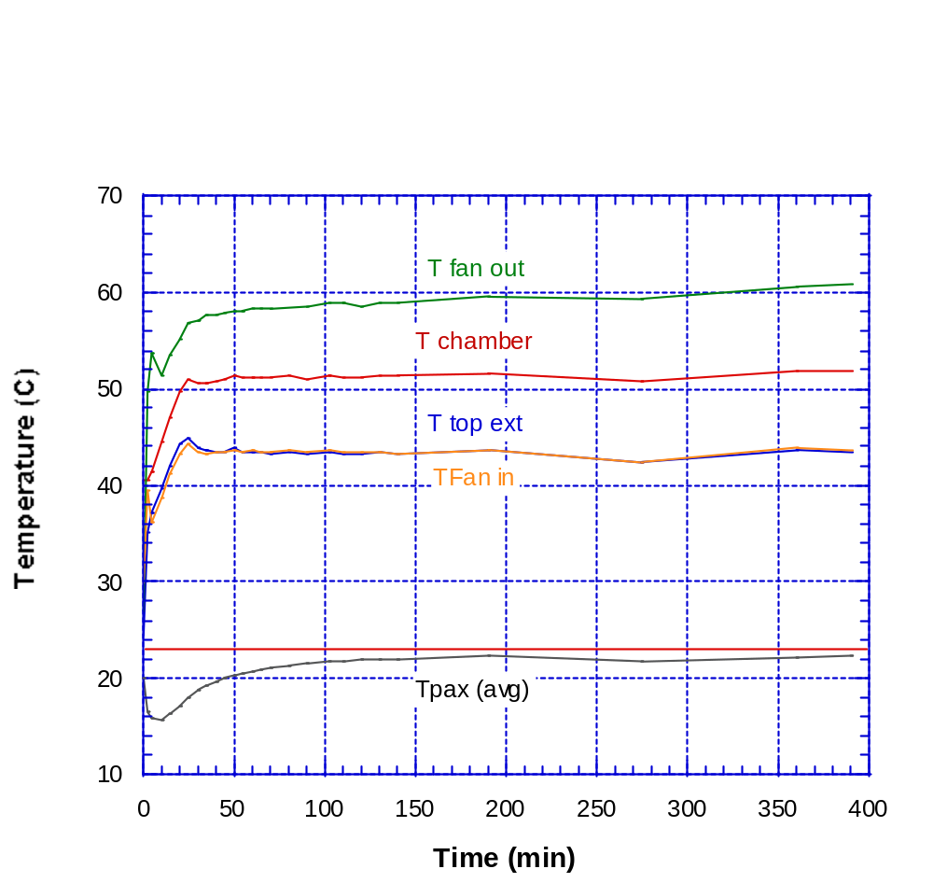
Phase V Test Results
Actual input air temp
Specified maximum
Specified maximum PAX temperature
Actual PAX average temperature

Slide 29
Recommended Future Measurements
Two more samples of the Therma-Shield heat sink have been ordered
Whether 4 or only 3 or even 2 TE coolers is needed to meet program requirements should be determined
  Even if fewer are needed, redundancy might be prudent
  Unclear whether 4 of the 39-W coolers with better heat sink might perform adequately
With a strong air flow across the cooling system, the need to raise coolers on ½” blocks is debatable
  Rapidly flowing air will heat the PAX less than stagnant air
Air flow needs to be increased above the output of the cryo-coolers.
  Fan system that takes advantage of the cryo-cooled air should improve overall cooling performance
  Actual location of fans required to blow air across heat fins in complete system needs TBD

